Slide 1
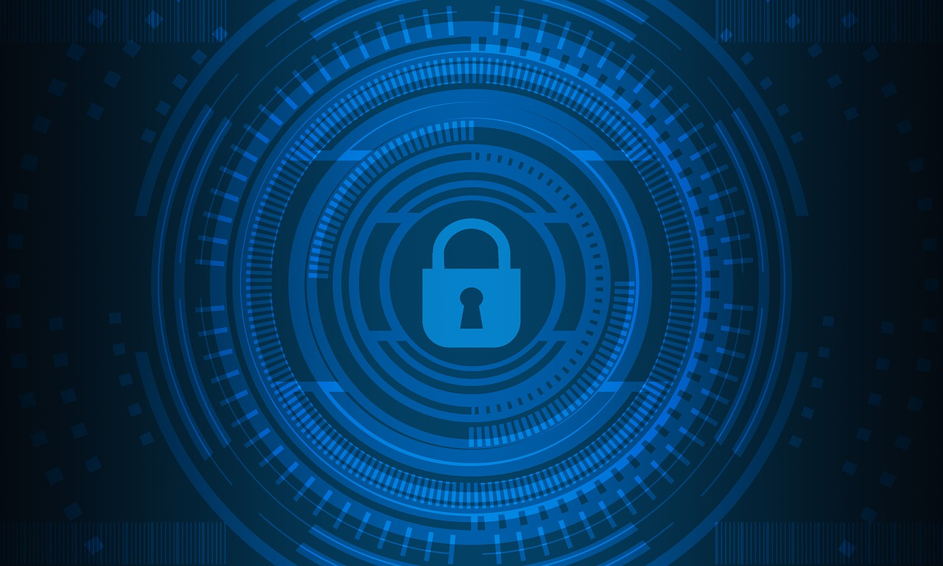
CYBER SECURITY
JIBBIN JACOB DANIEL
CSE A
ROLL NO:31

Slide 2
OUTLINE
Cyber Security
Why it is important ?
Cybercrimes
Types
Ways to prevent

Slide 3
What is Cyber Security?
Computer security, cybersecurity or information technology security (IT security)
Protection of Computer systems and networks from Theft or damage of there Hardware, software and electronic data from an external source
Significant
Computer networks, internet, wireless networks
Bluetooth, wifi.

Slide 4
Why is Cyber Security important?
Cybersecurity is important because it protects
Sensitive data
Personally identifiable information(PII)
Protected Health information(PHI)
Personal information
Intellectual property data
Government and industry data.
from theft and damage attempted by criminals and adversaries.

Slide 5
Cybercrime
Cybercrime, or computer-oriented crime, is a crime that involves a computer and a network.
Cybercrime may threaten a person, company or a nation's security and financial health.
The computer may have been used in the commission of a crime, or it may be the target.
A report (sponsored by McAfee), published in 2014, estimated that the annual damage to the global economy was $445 billion.

Slide 6
Types of Cyber Security threats

Slide 7
Adware
Virus
•Malware
Ransomware
Trojans
Spyware

Slide 8
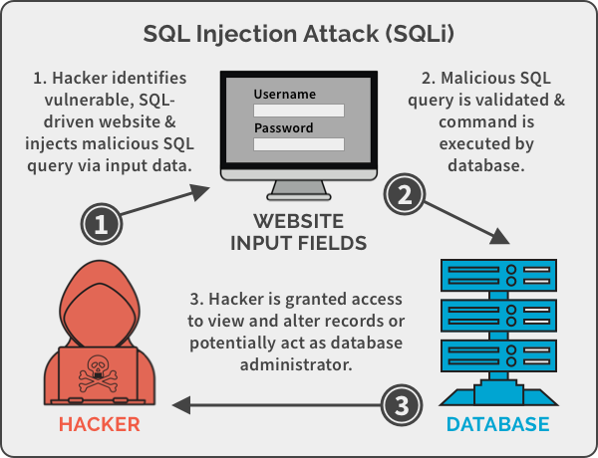
SQL injection:
SQL injection is a code injection technique that might destroy your database. SQL injection is one of the most common web hacking techniques. SQL injection is the placement of malicious code in SQL statements, via web page input.

Slide 9
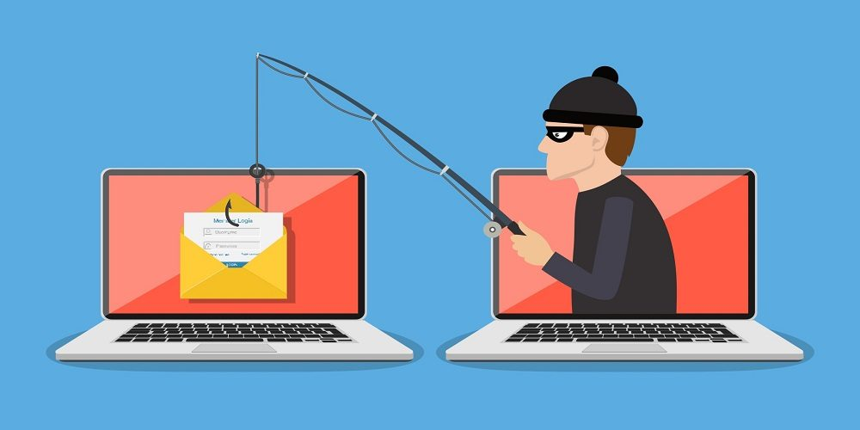
Phishing
Phishing is the attempt to acquire sensitive information such as usernames, passwords, and credit card details directly from users by deceiving the users.

Slide 10
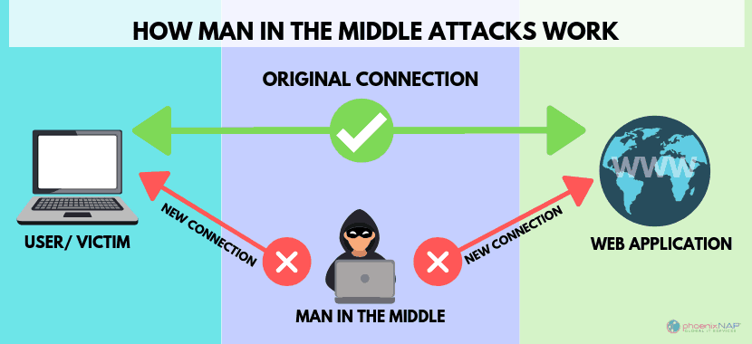
Man-in-the-middle attack
A man in the middle (MITM) attack is a general term for when a perpetrator positions himself in a conversation between a user and an application—either to eavesdrop or to impersonate one of the parties, making it appear as if a normal exchange of information is underway.

Slide 11
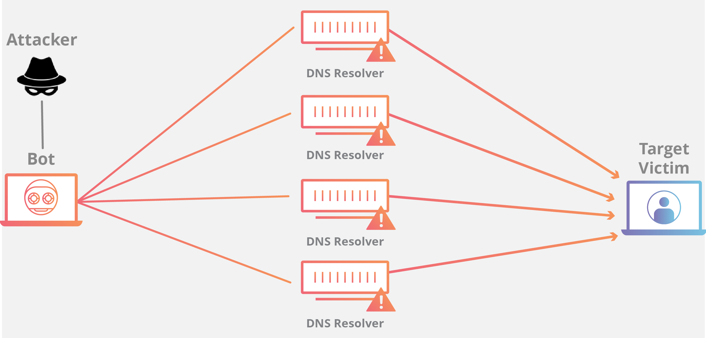
Denial-of-service attack
A Denial-of-Service (DoS) attack is an attack meant to shut down a machine or network, making it inaccessible to its intended users. DoS attacks accomplish this by flooding the target with traffic, or sending it information that triggers a crash.

Slide 12
Cyber safety tips - Protect yourself against cyberattacks
Update your software and operating system
Use anti-virus software
Use strong passwords
Do not open email attachments from unknown senders
Do not click on links in emails from unknown senders or unfamiliar websites
Avoid using unsecured Wi-Fi networks in public places

Slide 13
CONCLUSION
The only system which is truly secure is the one which is unplugged.

Slide 14
Bibliography
•Computer security – Wikipedia
•What is Cyber Security? | Definition, Types, and User Protection | Kaspersky
•What Is Cybersecurity? – Cisco
•Why is Cybersecurity Important? | UpGuard
•Cybercrime – Wikipedia
• Top Cyberattacks of 2020 and How to Build Cyberresiliency (isaca.org)

Slide 15
Thankyou

